Slide 1
Module 3 Windows File System and Registry Analysis
Elton Booker | Part-Time Lecturer | e.booker@northeastern.edu
Notes:
This page intentionally left blank.

Slide 2
Windows File System Basics
CY5210
Information System Forensics

Slide 3
Introduction to NTFS
CY5210
Information System Forensics

Slide 4
Introduction to Windows Registry
CY5210
Information System Forensics

Slide 5
Windows Registry
%WinDir%\System32\Config
SAM
SECURITY
SYSTEM
SOFTWARE
DEFAULT
Data files (hives)
Contain keys and values
Information
Hardware
User settings
Software
System settings

Slide 6
Registry Backup
%WinDir%\System32\Config\RegBack
SAM
SECURITY
SYSTEM
SOFTWARE
DEFAULT

Slide 7
Registry User Hives
%UserProfile%
NTUSER.DAT
USRCLASS.DAT
Local
Microsoft
Windows
AppData
Exists for every user
Used to identify user activity
Most important source
NTUSER.DAT
C:\Users\<username>\NTUSER.DAT (Win7-10)
USERCLASS.DAT
C:\Users\<username>\AppData\Local\Microsoft\Windows\USRCLASS.DAT

Slide 8
Registry Hives
Hive Name | Abbrev. | File
HKEY_LOCAL_MACHINE\SAM | HKLM\SAM | SAM
HKEY_LOCAL_MACHINE\Security | HKLM\Security | SECURITY
HKEY_LOCAL_MACHINE\System | HKLM\System | SYSTEM
HKEY_LOCAL_MACHINE\Software | HKLM\Software | SOFTWARE
HKEY_USER or CURRENT_USER | HKCU | NTUSER.DAT/USRCLASS.DAT

Slide 9
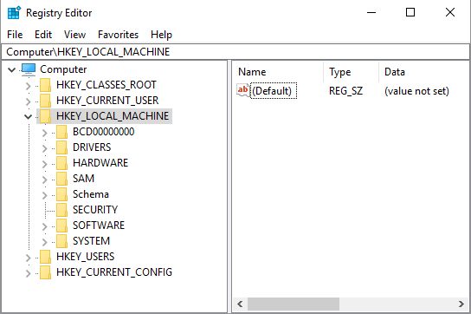
Registry Hives – File Names
System hives
SYSTEM
SECURITY
SOFTWARE
SAM
User hives*
NTUSER.DAT
USRCLASS.DAT

Slide 10
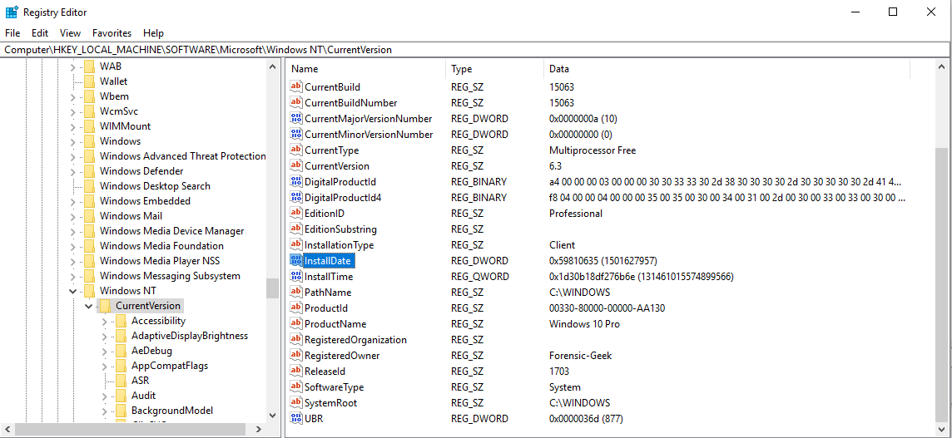
Registry Structure – Registry Editor

Slide 11

Registry Forensic Tools
Registry Ripper (RegRipper)
AD Registry Viewer
TZWorks YARU
Registry Explorer

Slide 12
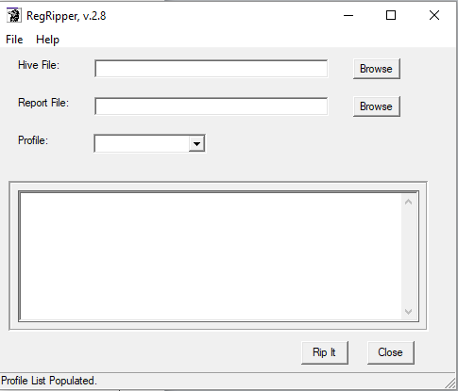
Registry Ripper (Regripper)
Automated Registry Ripping
Perl-based
Windows GUI
Hivefile
Report file
Plugin type / Profile
Command-line options

Slide 13
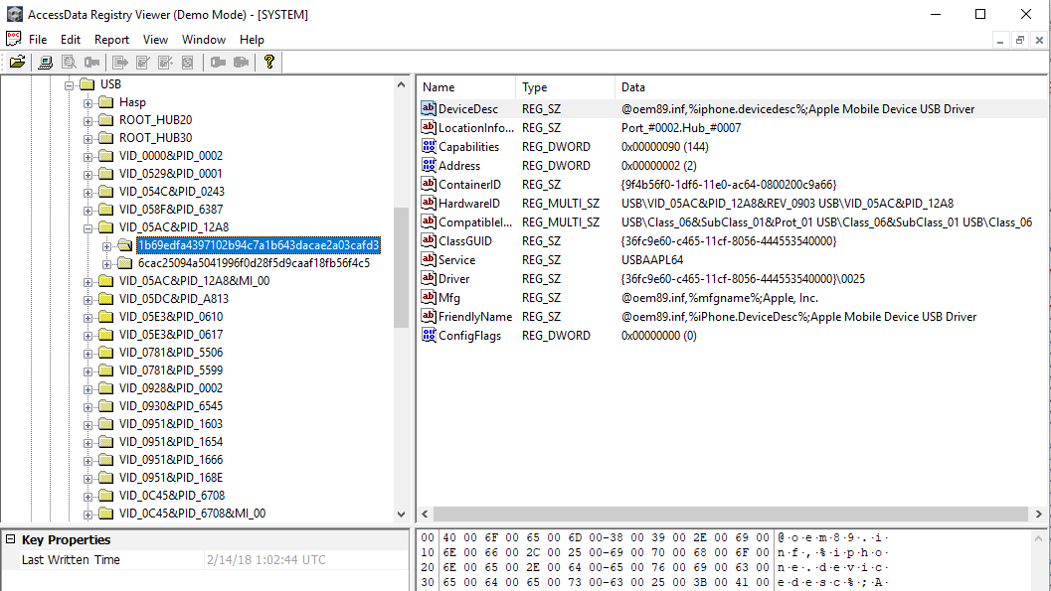
AccessData Registry Viewer

Slide 14
Demo: Registry Ripper
CY5210
Information System Forensics

Slide 15
Registry: Account and System Information
CY5210
Information System Forensics

Slide 16
SAM: Profiling Users/Groups
Username
Security Identifier (SID)
User Login Information
Last Login
Last Failed Login
Logon Count (unless MS account)
Password Policy
Account Creation Time
Group Information
Administrators
Users
Remote Desktop Users

Slide 17
Profiling Local Users
Intent
Lists local accounts and security identifiers
Location
SAM\Domains\Account\Users\
Investigations
Discover username and respective SID
Information related to user activity
Last Login
Last Failed Login
Account Creation Time

Slide 18
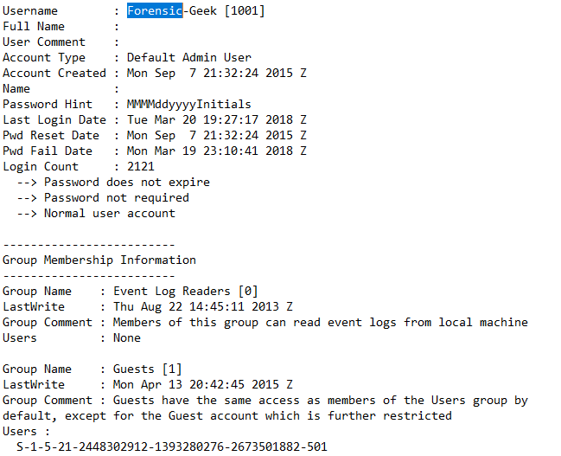
SAM Parsing with RegRipper
Account Created: Not in AD Registry Viewer
Group Info: Not displayed in AD Registry Viewer

Slide 19
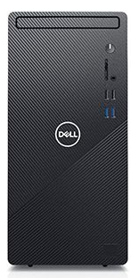
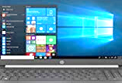
System Information
Microsoft OS Version
Current Control Set
Computer Name
Time Zone (Local)
Network Interfaces
Historical Networks
Autostart Programs
System Shares
Last Shutdown Time

Slide 20
Current Control Set
Intent
Identifies the current control set (ControlSet00X)
System configuration settings
Location
SYSTEM\Select
SYSTEM\Select\Current
Investigations
Identifies the last known good configuration to focus on

Slide 21
Computer Name
Intent
Identifies the system name in System Properties
Location
SYSTEM\CurrentControlSet\Control\ComputerName\ComputerName
Investigations
Used for log files, network connections, and other network activity
Verifies the system you are investigating with other evidence

Slide 22
Time Zone Information
Intent
Current system time zone
Location
SYSTEM\CurrentControlSet\Control\TimeZoneInformation
Investigations
Time information needed to coordinate activity
Internal activity and date/timestamps will be based on the system time zone information
Correlate network data and evidence
FS time stamps local time; registry in UTC

Slide 23
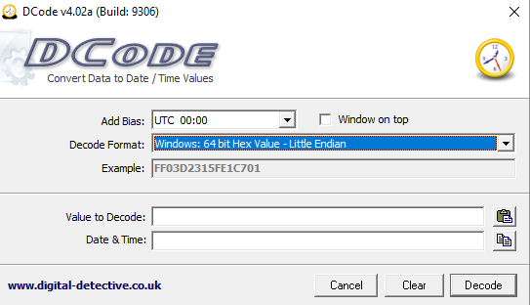
Dcode Date Tool

Slide 24
Network Shares
Intent
List network shares on local system
Lists flags and configuration settings
Location
SYSTEM\CurrentControlSet\Services\lanmanserver\Shares\
Investigations
Types of shares and local path
No shares – then none created

Slide 25
System Autostart Programs
Intent
Lists programs started at system boot
Location
NTUSER.DAT\Software\Microsoft\Windows\CurrentVersion\Run
NTUSER.DAT\Software\Microsoft\Windows\CurrentVersion\RunOnce
Software\Microsoft\Windows\CurrentVersion\Run
Software\Microsoft\Windows\CurrentVersion\RunOnce
Investigations
Determine programs to start automatically
Useful to identify malware and rootkits
Key last updated typically last boot time of system

Slide 26
Shutdown Information
Intent
Identify when system was last shutdown
How many times the system shutdown successfully
Location
SYSTEM\CurrentControlSet\Control\Windows (Shutdown Time)
Investigations
Last shutdown time detect certain activity
Identifies if user properly shuts down system

Slide 27
Registry: User Activity
CY5210
Information System Forensics

Slide 28

User Activity Artifacts
File Download
Program Execution
File Opening and Creation
File Knowledge
USB Key Usage

Slide 29
Windows Search History
Intent
File knowledge or interest
Prove knowledge of a location
Location
NTUSER.DAT\Software\Microsoft\Windows\CurrentVersionExplorer\WordWheelQuery
Investigations
Identify any searches performed by the user or attacker
Includes the Explorer bar in Win8/10 since there is not real Start button
No MRU key

Slide 30
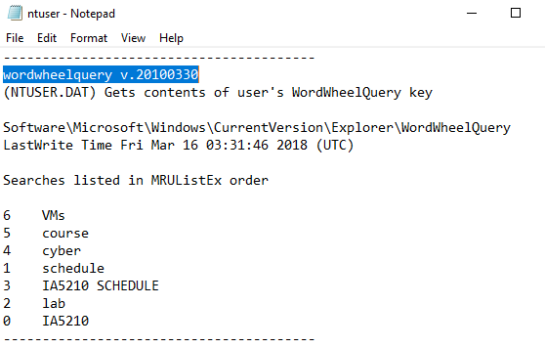
What Has the User Searched For?
RegRipper Output – Run against NTUSER.DAT hive

Slide 31
Typed Paths
Intent
Prove file knowledge or interest
Location
NTUSER.DAT\Software\Microsoft\Windows\CurrentVersion\Explorer\Typed Paths
Investigations
Populated when a user manually types a path into the Explorer bar or Start menu

Slide 32
Recent Docs
Intent
Identify mostly used recent documents
Location
NTUSER.DAT\Software\Microsoft\Windows\CurrentVersion\Explorer\...
RecentDocs
Investigations
MRU list order

Slide 33
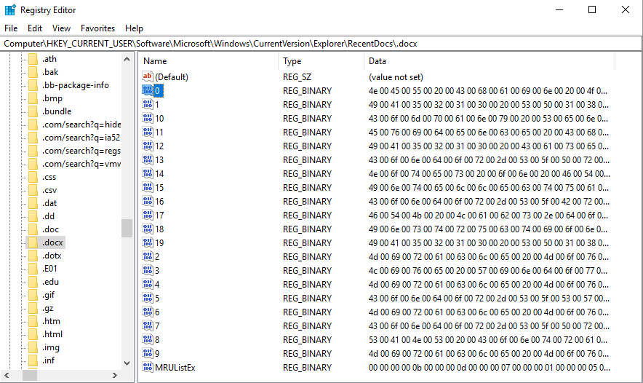
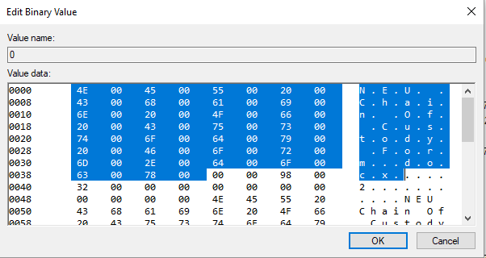
Recent Docs Example

Slide 34
Microsoft Office RecentDocs (1)
Intent
Identify MS Office documents prior to Office365
Covers up through 14.0 (Office 2010)
Location
NTUSER.DAT\Software\Microsoft\Office\VERSION
Investigations
May identify last 50 files accessed

Slide 35
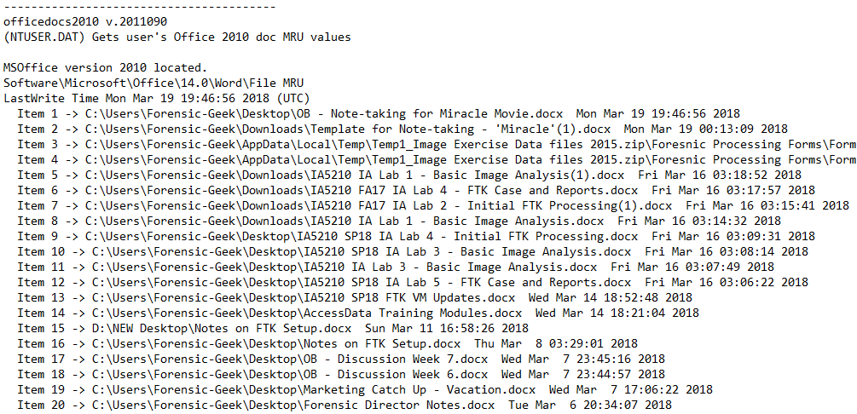
Microsoft Office RecentDocs (2)

Slide 36
Last Executed Commands
Intent
Identify the commands a user has executed
Location
\Software\Microsoft\Windows\CurrentVersion\Explorer\RunMRU
\Software\Microsoft\Windows\CurrentVersion\Explorer\Policies\RunMRU
Investigations
MRUlist identifies the order in which commands were executed
Commands typed into the START -> RUN box

Slide 37
UserAssist Key
Intent
Program execution for a specific user
Location
NTUSER.DAT\Software\Microsoft\Windows\CurrentVersion\UserAssist\...
{GUID}\Count
Investigations
Time program last executed
How many times a program executed
Name of application

Slide 38


Slide 39
Demo: Registry Ripper
CY5210
Information System Forensics

